Slide 1
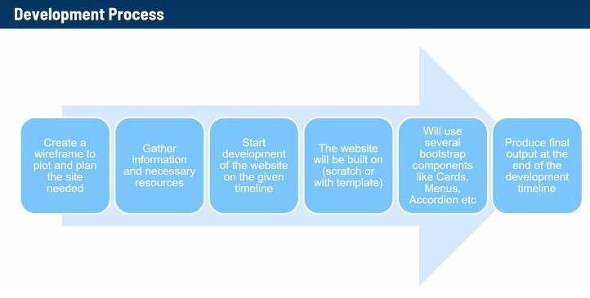

Slide 2


BR MOTORCYCLE GARAGE
We are Selling brand new motorcycle for our customer’s. We have a commercial website so you can browse or choose your vehicle and feel free to contact us and visit our shop.
BrMG are providing additional support with our services, we are offering maintenance and vehicle repairs with warranty
We provide best care for our customer’s vehicles and effectively solve all issues and problems
It is our mission to exceed our customer’s and employee’s expectations and maintain their loyalty for a lifetime

